Slide 1


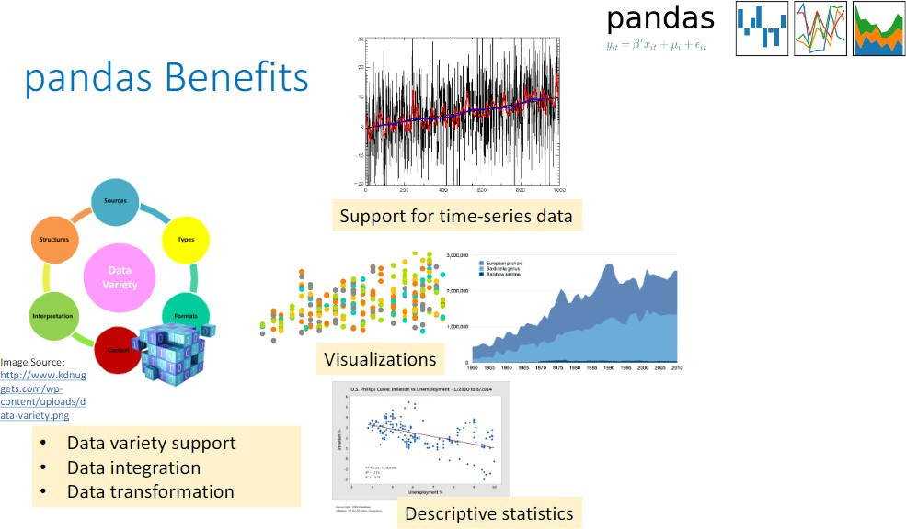

Slide 2

Pandas
pandas is a Python library for data analysis. It offers a number of data exploration, cleaning and transformation operations that are critical in working with data in Python.
pandas build upon numpy and scipy providing easy-to-use data structures and data manipulation functions with integrated indexing.

Slide 3
The main data structures pandas provides are Series and DataFrames. After a brief introduction to these two data structures and data ingestion, the key features of pandas this notebook covers are:
Generating descriptive statistics on data Data cleaning using built in pandas functions
Frequent data operations for subsetting, filtering, insertion, deletion and aggregation of data
Merging multiple datasets using dataframes Working with timestamps and time-series data

Slide 4
Additional Recommended Resources:
pandas Documentation: http://pandas.pydata.org/pandas-docs/stable/ (http://pandas.pydata.org/pandas-docs/stable/)
Python for Data Analysis by Wes McKinney
Python Data Science Handbook by Jake VanderPlas
Let's get started with our first pandas notebook!

Slide 5
Introduction to pandas Data Structures
In [1]:
import pandas as pd
*pandas* has two main data structures it uses, namely, *Series* and *DataFrames*.
pandas Series
pandas Series one-dimensional labeled array.

Slide 6
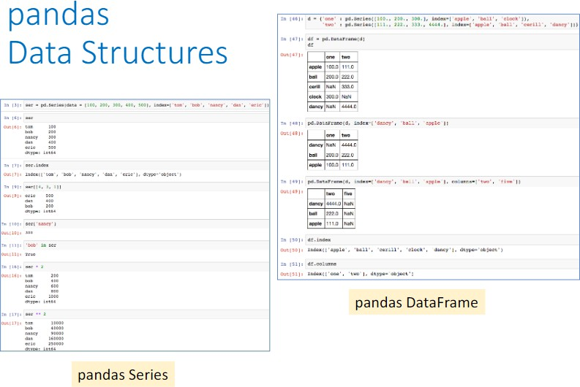

Slide 7
In [2]:
ser = pd.Series([100, 'foo', 300, 'bar', 500], ['tom', 'bob', 'nancy', 'dan', 'eric']) print(ser)
tom bob nancy dan eric
100
foo 300
bar
500
dtype: object
In [3]:
ser.index
Out[3]:
Index(['tom', 'bob', 'nancy', 'dan', 'eric'], dtype='object')

Slide 8
In [4]:
ser.loc[['nancy','bob']]
Out[4]: | nancy bob dtype: | 300 foo object
In [5]: | ser[[4, | 3, 1]]
Out[5]: | eric dan | 500 bar
 | bob | foo
 | dtype: | object

Slide 9
In [6]:
ser.iloc[2]
Out[6]:
300
In [7]:
'bob' in ser
Out[7]:
True

Slide 10
In [8]:
print(ser) print(ser*2)
tom bob nancy dan eric
100
foo 300
bar
500
dtype: object
tom bob nancy dan eric
200
foofoo
600
barbar
1000
dtype: object
In [9]:
ser[['nancy', 'eric']] ** 2
Out[9]:
nancy eric
90000
250000
dtype: object

Slide 11
pandas DataFrame
pandas DataFrame is a 2-dimensional labeled data structure.
Create DataFrame from dictionary of Python Series
In [10]:
d = {'one' : pd.Series([100., 200., 300.], index=['apple', 'ball', 'clock']),
'two' : pd.Series([111., 222., 333., 4444.], index=['apple', 'ball', 'cerill', 'dan cy'])}
df = pd.DataFrame(d)

Slide 12
In [11]:
df
Out[11]:
one
two
apple | 100.0 | 111.0
ball | 200.0 | 222.0
cerill | NaN | 333.0
clock | 300.0 | NaN
dancy | NaN | 4444.0

Slide 13
Other way to do the same
In [12]:
d = {'one' : [100., 200.,float("NaN"), 300., float("NaN")],'two':[111., 222., 333., floa
t("NaN"),4444.],"tmp_index":['apple', 'ball', 'cerill', 'clock', 'dancy']} df=pd.DataFrame(data=d)
df.set_index("tmp_index",inplace=True)
df.index.name = None
df
Out[12]:
 | one | two
apple | 100.0 | 111.0
ball | 200.0 | 222.0
cerill | NaN | 333.0
clock | 300.0 | NaN
dancy | NaN | 4444.0

Slide 14
In [13]:
d = {'one' : pd.Series([100., 200., 300.], index=['apple', 'ball', 'clock']),
'two' : pd.Series([111., 222., 333., 4444.], index=['apple', 'ball', 'cerill', 'dan cy'])}
df = pd.DataFrame(d)
pd.DataFrame(d, index=['dancy', 'ball', 'apple'])
Out[13]:
 | one | two
dancy | NaN | 4444.0
ball | 200.0 | 222.0
apple | 100.0 | 111.0

Slide 15
In [14]:
pd.DataFrame(d, index=['dancy', 'ball', 'apple'], columns=['two', 'five'])
Out[14]:
 | two | five
dancy | 4444.0 | NaN
ball | 222.0 | NaN
apple | 111.0 | NaN

Slide 16
Create DataFrame from list of Python dictionaries
In [15]:
data = [{'alex': 1, 'joe': 2}, {'ema': 5, 'dora': 10, 'alice': 20}]

Slide 17
In [16]:
pd.DataFrame(data)
Out[16]:
alex | alice | dora | ema | joe
0 1.0 | NaN | NaN | NaN | 2.0
1 NaN | 20.0 | 10.0 | 5.0 | NaN
In [17]:
pd.DataFrame(data, index=['orange', 'red'])
Out[17]:
alex | alice | dora | ema | joe
orange 1.0 | NaN | NaN | NaN | 2.0
red NaN | 20.0 | 10.0 | 5.0 | NaN

Slide 18
In [18]:
pd.DataFrame(data, columns=['joe', 'dora','alice'])
Out[18]:
joe | dora | alice
0 2.0 | NaN | NaN
1 NaN | 10.0 | 20.0

Slide 19
Basic DataFrame operations

Slide 20
In [19]:
df
Out[19]:
one
two
apple | 100.0 | 111.0
ball | 200.0 | 222.0
cerill | NaN | 333.0
clock | 300.0 | NaN
dancy | NaN | 4444.0

Slide 21
In [20]:
df['one']
Out[20]:
apple ball cerill clock dancy
100.0
200.0
NaN 300.0
NaN
Name: one, dtype: float64
In [21]:
df['three'] = df['one'] * df['two'] df
Out[21]:
 | one | two | three
apple | 100.0 | 111.0 | 11100.0
ball | 200.0 | 222.0 | 44400.0
cerill | NaN | 333.0 | NaN
clock | 300.0 | NaN | NaN
dancy | NaN | 4444.0 | NaN

Slide 22
In [22]:
df['flag'] = df['one'] > 250 df
Out[22]:
 | one | two | three | flag
apple | 100.0 | 111.0 | 11100.0 | False
ball | 200.0 | 222.0 | 44400.0 | False
cerill | NaN | 333.0 | NaN | False
clock | 300.0 | NaN | NaN | True
dancy | NaN | 4444.0 | NaN | False
In [23]:
three = df.pop('three') three
Out[23]:
apple ball cerill clock dancy
11100.0
44400.0
NaN NaN NaN
Name: three, dtype: float64

Slide 23
In [24]:
df
Out[24]:
 | one | two | flag
apple | 100.0 | 111.0 | False
ball | 200.0 | 222.0 | False
cerill | NaN | 333.0 | False
clock | 300.0 | NaN | True
dancy | NaN | 4444.0 | False
In [25]:
del df['two']

Slide 24
In [26]:
df
Out[26]:
one flag
apple | 100.0 | False
ball | 200.0 | False
cerill | NaN | False
clock | 300.0 | True
dancy | NaN | False

Slide 25
In [27]:
df.insert(2, 'copy_of_one', df['one']) df
Out[27]:
one flag copy_of_one
apple | 100.0 | False | 100.0
ball | 200.0 | False | 200.0
cerill | NaN | False | NaN
clock | 300.0 | True | 300.0
dancy | NaN | False | NaN

Slide 26
In [28]:
df['one_upper_half'] = df['one'][:2] df
Out[28]:
one flag copy_of_one one_upper_half
apple | 100.0 | False | 100.0 | 100.0
ball | 200.0 | False | 200.0 | 200.0
cerill | NaN | False | NaN | NaN
clock | 300.0 | True | 300.0 | NaN
dancy | NaN | False | NaN | NaN

Slide 27
In [29]:
df.dropna(axis=0,thresh=2)
Out[29]:
 | one | flag | copy_of_one | one_upper_half
apple | 100.0 | False | 100.0 | 100.0
ball | 200.0 | False | 200.0 | 200.0
clock | 300.0 | True | 300.0 | NaN

Slide 28
Case Study: Movie Data Analysis
This notebook uses a dataset from the MovieLens website. We will describe the dataset further as we explore with it using pandas.
Download the Dataset
Please note that you will need to download the dataset.
Here are the links to the data source and location:
Data Source: MovieLens web site (filename: ml-20m.zip) Location: https://grouplens.org/datasets/movielens/ (https://grouplens.org/datasets/movielens/)

Slide 29
Once the download completes, please make sure the data files are in a directory called
movielens
Let us look at the files in this dataset using the UNIX command ls.

Slide 30
In [30]:
%%bash
ls movielens/Large/
README.txt
genome-scores.csv genome-tags.csv links.csv movies.csv ratings.csv tags.csv
In [31]:
%%bash
cat movielens/Large/movies.csv | wc -l
27279

Slide 31
In [32]:
%%bash
cat movielens/Large/ratings.csv | wc -l
20000264
In [33]:
%%bash
head -5 ./movielens/Large/ratings.csv
userId,movieId,rating,timestamp 1,2,3.5,1112486027
1,29,3.5,1112484676
1,32,3.5,1112484819
1,47,3.5,1112484727

Slide 32
Use Pandas to Read the Dataset
In this notebook, we will be using three CSV files:
ratings.csv : userId,movieId,rating, timestamp tags.csv : userId,movieId, tag, timestamp movies.csv : movieId, title, genres
Using the read_csv function in pandas, we will ingest these three files.

Slide 33
In [34]:
movies = pd.read_csv('./movielens/Large/movies.csv', sep=',') print(type(movies))
movies.head(15)
<class 'pandas.core.frame.DataFrame'>
Out[34]:
movieId | title | genres
0 1 | Toy Story (1995) | Adventure|Animation|Children|Comedy|Fantasy
1 2 | Jumanji (1995) | Adventure|Children|Fantasy
2 3 | Grumpier Old Men (1995) | Comedy|Romance
3 4 | Waiting to Exhale (1995) | Comedy|Drama|Romance
4 5 | Father of the Bride Part II (1995) | Comedy
5 6 | Heat (1995) | Action|Crime|Thriller
6 7 | Sabrina (1995) | Comedy|Romance
7 8 | Tom and Huck (1995) | Adventure|Children
8 9 | Sudden Death (1995) | Action
9 10 | GoldenEye (1995) | Action|Adventure|Thriller
10 11 | American President, The (1995) | Comedy|Drama|Romance
11 12 | Dracula: Dead and Loving It (1995) | Comedy|Horror
12 13 | Balto (1995) | Adventure|Animation|Children
13 14 | Nixon (1995) | Drama
14 15 | Cutthroat Island (1995) | Action|Adventure|Romance

Slide 34
In [35]:
tags = pd.read_csv('./movielens/Large/tags.csv', sep=',') tags.head()
Out[35]:
userId | movieId | tag | timestamp
0 18 | 4141 | Mark Waters | 1240597180
1 65 | 208 | dark hero | 1368150078
2 65 | 353 | dark hero | 1368150079
3 65 | 521 | noir thriller | 1368149983
4 65 | 592 | dark hero | 1368150078

Slide 35
In [36]:
ratings = pd.read_csv('./movielens/Large/ratings.csv', sep=',', parse_dates=['timestamp'
])
ratings.head()
Out[36]:
userId | movieId | rating | timestamp
0 1 | 2 | 3.5 | 1112486027
1 1 | 29 | 3.5 | 1112484676
2 1 | 32 | 3.5 | 1112484819
3 1 | 47 | 3.5 | 1112484727
4 1 | 50 | 3.5 | 1112484580

Slide 36
For current analysis, we will remove the Timestamp ( we could get to it later if you want)
In [37]:
del ratings['timestamp']
del tags['timestamp']

Slide 37
Data Structures
Series

Slide 38
In [38]:
row_0 = tags.iloc[0] print(type(row_0)) print(row_0)
<class 'pandas.core.series.Series'>
userId movieId tag
18
4141
Mark Waters
Name: 0, dtype: object
In [39]:
row_0.index
Out[39]:
Index(['userId', 'movieId', 'tag'], dtype='object')

Slide 39
In [40]:
row_0['userId']
Out[40]:
18
In [41]:
'rating' in row_0
Out[41]:
False

Slide 40
In [42]:
row_0.name
Out[42]:
0
In [43]:
row_0 = row_0.rename('first_row') row_0.name
Out[43]:
'first_row'

Slide 41
Descriptive Statistics
Let's look how the ratings are distributed!
In [44]:
ratings.describe()
Out[44]:
 | userId | movieId | rating
count | 2.000026e+07 | 2.000026e+07 | 2.000026e+07
mean | 6.904587e+04 | 9.041567e+03 | 3.525529e+00
std | 4.003863e+04 | 1.978948e+04 | 1.051989e+00
min | 1.000000e+00 | 1.000000e+00 | 5.000000e-01
25% | 3.439500e+04 | 9.020000e+02 | 3.000000e+00
50% | 6.914100e+04 | 2.167000e+03 | 3.500000e+00
75% | 1.036370e+05 | 4.770000e+03 | 4.000000e+00
max | 1.384930e+05 | 1.312620e+05 | 5.000000e+00

Slide 42
In [45]:
ratings.mode()
Out[45]:
userId movieId rating
0 118205 296 4.0
In [46]:
ratings.corr()
Out[46]:
 | userId | movieId | rating
userId | 1.000000 | -0.000850 | 0.001175
movieId | -0.000850 | 1.000000 | 0.002606
rating | 0.001175 | 0.002606 | 1.000000

Slide 43
In [47]:
filter_2 = ratings.loc[ratings['rating'] > 0]

Slide 44
In [48]:
filter_2.groupby("movieId").mean()
Out[48]:
 | userId | rating
movieId
1 | 69282.396821 | 3.921240
2 | 69169.928202 | 3.211977
3 | 69072.079388 | 3.151040
4 | 69652.913280 | 2.861393
5 | 69113.475454 | 3.064592
6 | 69226.328633 | 3.834930
7 | 69100.961809 | 3.366484
8 | 68677.092580 | 3.142049
9 | 70310.064899 | 3.004924
10 | 69161.741045 | 3.430029
11 | 69529.290717 | 3.667713
12 | 69245.668661 | 2.619766
13 | 70136.308693 | 3.272416
14 | 69468.605945 | 3.432082
15 | 69273.411684 | 2.721993
16 | 68817.899103 | 3.787455
17 | 69093.916727 | 3.968573
18 | 69830.091293 | 3.373631
19 | 69367.608129 | 2.607412
20 | 69822.326151 | 2.880754
21 | 69448.155374 | 3.581689
22 | 68741.821011 | 3.319400
23 | 70304.317176 | 3.148235
24 | 68901.418517 | 3.199849
25 | 69241.775855 | 3.689510
26 | 70215.360799 | 3.628857
27 | 67274.806943 | 3.413520
28 | 69610.200698 | 4.057546
29 | 69010.756925 | 3.952230
30 | 70776.333333 | 3.633880
... | ... | ...

Slide 45
 | userId | rating
movieId
131146 | 79570.000000 | 4.000000
131148 | 79570.000000 | 4.000000
131150 | 79570.000000 | 4.000000
131152 | 74937.000000 | 0.500000
131154 | 79570.000000 | 3.500000
131156 | 79570.000000 | 4.000000
131158 | 108819.000000 | 4.000000
131160 | 79570.000000 | 4.000000
131162 | 42229.000000 | 2.000000
131164 | 54560.000000 | 4.000000
131166 | 54560.000000 | 4.000000
131168 | 64060.000000 | 3.500000
131170 | 95841.000000 | 3.500000
131172 | 128309.000000 | 1.000000
131174 | 109286.000000 | 3.500000
131176 | 109286.000000 | 4.500000
131180 | 117144.000000 | 2.500000
131231 | 63046.000000 | 3.500000
131237 | 134701.000000 | 3.000000
131239 | 79570.000000 | 4.000000
131241 | 79570.000000 | 4.000000
131243 | 79570.000000 | 4.000000
131248 | 79570.000000 | 4.000000
131250 | 79570.000000 | 4.000000
131252 | 79570.000000 | 4.000000
131254 | 79570.000000 | 4.000000
131256 | 79570.000000 | 4.000000
131258 | 28906.000000 | 2.500000
131260 | 65409.000000 | 3.000000
131262 | 133047.000000 | 4.000000
26744 rows × 2 columns

Slide 46
Data Cleaning: Handling Missing Data
In [49]:
movies.shape
Out[49]:
(27278, 3)

Slide 47
Is there any row Null?
In [50]:
movies.isnull().any()
Out[50]:
movieId title genres
False False False
dtype: bool
Nice!!, so we do not have to worry about this!

Slide 48
In [51]:
ratings.shape
Out[51]:
(20000263, 3)
In [52]:
ratings.isnull().any()
Out[52]:
userId movieId rating
False False False
dtype: bool
Nice!!, so we do not have to worry about this!

Slide 49
In [53]:
tags.shape
Out[53]:
(465564, 3)
In [54]:
tags.isnull().any()
Out[54]:
userId movieId tag
False False True
dtype: bool
Unfortunately we will have to deal with NaN values in this data set

Slide 50
We check agaiin if there is any row null
In [55]:
tags = tags.dropna()
In [56]:
tags.isnull().any()
Out[56]:
userId movieId tag
False False False
dtype: bool

Slide 51
Thats nice! Nonetheless, notice that the number of lines have
reduced.
In [57]:
tags.shape
Out[57]:
(465548, 3)

Slide 52
Data Visualization
In [58]:
import matplotlib.pylab as plt

Slide 53
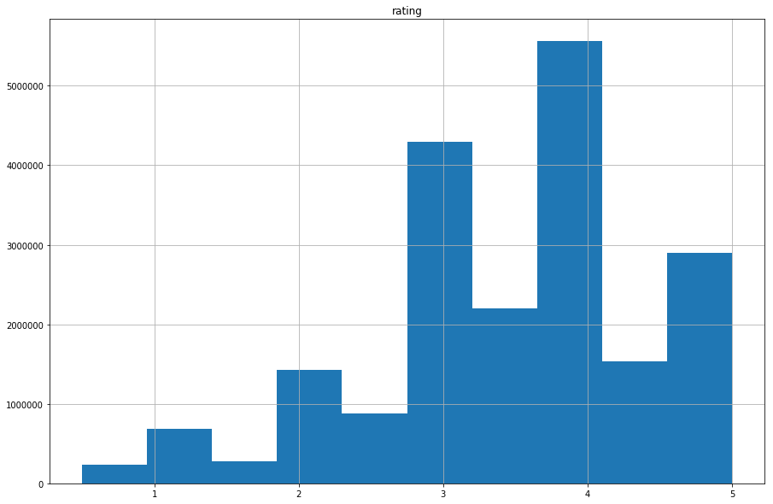
In [59]:
ratings.hist(column='rating', figsize=(15,10),bins=10) plt.show()

Slide 54
Getting information from columns
In [60]:
tags['tag'].head()
Out[60]:
0
1
2
3
4
Mark Waters dark hero dark hero noir thriller
dark hero
Name: tag, dtype: object
In [61]:
movies[['title','genres']].head()
Out[61]:
title
genres
0 Toy Story (1995)
Adventure|Animation|Children|Comedy|Fantasy
1 Jumanji (1995)
Adventure|Children|Fantasy
2 Grumpier Old Men (1995)
Comedy|Romance
3 Waiting to Exhale (1995)
Comedy|Drama|Romance
4 Father of the Bride Part II (1995)
Comedy

Slide 55
In [62]:
ratings[-10:]
Out[62]:
 | userId | movieId | rating
20000253 | 138493 | 60816 | 4.5
20000254 | 138493 | 61160 | 4.0
20000255 | 138493 | 65682 | 4.5
20000256 | 138493 | 66762 | 4.5
20000257 | 138493 | 68319 | 4.5
20000258 | 138493 | 68954 | 4.5
20000259 | 138493 | 69526 | 4.5
20000260 | 138493 | 69644 | 3.0
20000261 | 138493 | 70286 | 5.0
20000262 | 138493 | 71619 | 2.5

Slide 56
In [63]:
ratings.tail(10)
Out[63]:
 | userId | movieId | rating
20000253 | 138493 | 60816 | 4.5
20000254 | 138493 | 61160 | 4.0
20000255 | 138493 | 65682 | 4.5
20000256 | 138493 | 66762 | 4.5
20000257 | 138493 | 68319 | 4.5
20000258 | 138493 | 68954 | 4.5
20000259 | 138493 | 69526 | 4.5
20000260 | 138493 | 69644 | 3.0
20000261 | 138493 | 70286 | 5.0
20000262 | 138493 | 71619 | 2.5

Slide 57
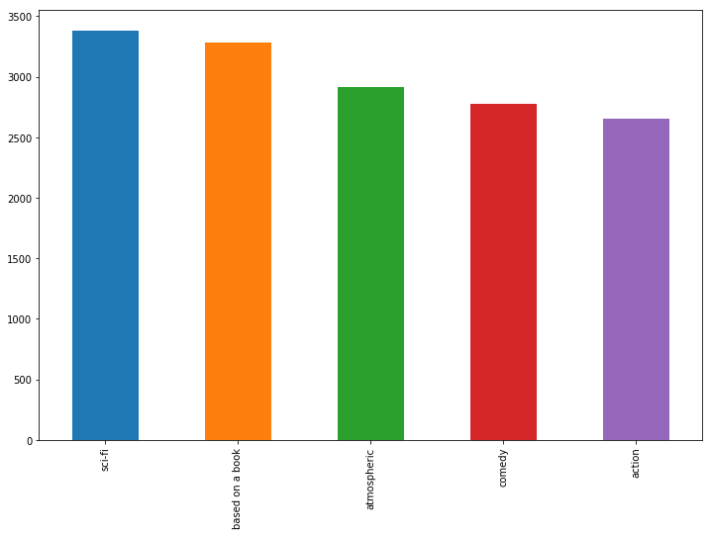
In [64]:
tag_counts = tags['tag'].value_counts() tag_counts.head().plot(kind='bar', figsize=(12,8))
Out[64]:
<matplotlib.axes._subplots.AxesSubplot at 0x26381863b38>

Slide 58
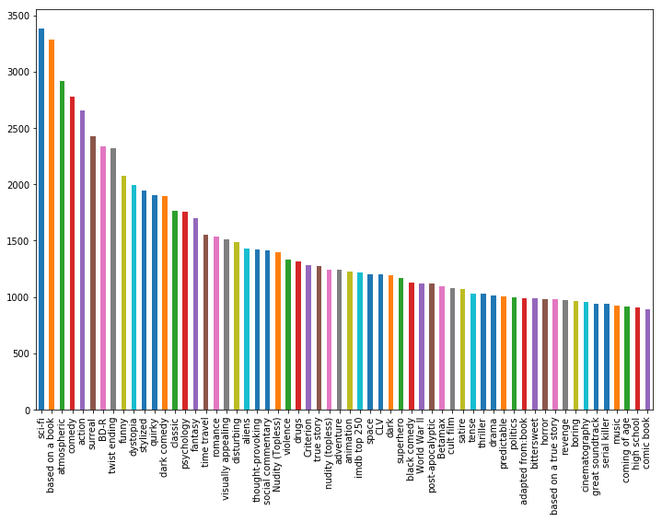
In [65]:
tag_counts.head(60).plot(kind='bar', figsize=(12,8))
Out[65]:
<matplotlib.axes._subplots.AxesSubplot at 0x26380380710>

Slide 59
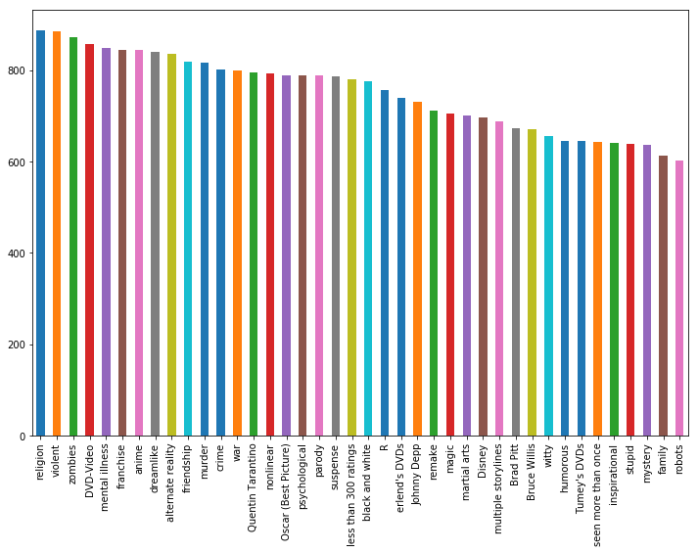
In [66]:
tag_counts[60:100].plot(kind='bar', figsize=(12,8))
Out[66]:
<matplotlib.axes._subplots.AxesSubplot at 0x26381902780>

Slide 60
Filters for Selecting Rows
In [67]:
is_highly_rated = ratings['rating'] >= 4.0 ratings[is_highly_rated].head()
Out[67]:
userId | movieId | rating
6 1 | 151 | 4.0
7 1 | 223 | 4.0
8 1 | 253 | 4.0
9 1 | 260 | 4.0
10 1 | 293 | 4.0

Slide 61
In [68]:
is_animation = movies['genres'].str.contains('Animation') movies[is_animation].head(15)
Out[68]:
 | movieId | title | genres
0 | 1 | Toy Story (1995) | Adventure|Animation|Children|Comedy|Fantasy
12 | 13 | Balto (1995) | Adventure|Animation|Children
47 | 48 | Pocahontas (1995) | Animation|Children|Drama|Musical|Romance
236 | 239 | Goofy Movie, A (1995) | Animation|Children|Comedy|Romance
241 | 244 | Gumby: The Movie (1995) | Animation|Children
310 | 313 | Swan Princess, The (1994) | Animation|Children
360 | 364 | Lion King, The (1994) | Adventure|Animation|Children|Drama|Musical|IMAX
388 | 392 | Secret Adventures of Tom Thumb, The (1993) | Adventure|Animation
547 | 551 | Nightmare Before Christmas, The (1993) | Animation|Children|Fantasy|Musical
553 | 558 | Pagemaster, The (1994) | Action|Adventure|Animation|Children|Fantasy
582 | 588 | Aladdin (1992) | Adventure|Animation|Children|Comedy|Musical
588 | 594 | Snow White and the Seven Dwarfs (1937) | Animation|Children|Drama|Fantasy|Musical
589 | 595 | Beauty and the Beast (1991) | Animation|Children|Fantasy|Musical|Romance|IMAX
590 | 596 | Pinocchio (1940) | Animation|Children|Fantasy|Musical
604 | 610 | Heavy Metal (1981) | Action|Adventure|Animation|Horror|Sci-Fi

Slide 62
In [69]:
ratings_count = ratings[['movieId','rating']].groupby('rating').count() ratings_count
Out[69]:
 | movieId
rating
0.5 | 239125
1.0 | 680732
1.5 | 279252
2.0 | 1430997
2.5 | 883398
3.0 | 4291193
3.5 | 2200156
4.0 | 5561926
4.5 | 1534824
5.0 | 2898660

Slide 63
Group By and Aggregate
In [70]:
average_rating = ratings[['movieId','rating']].groupby('movieId').mean() # We are not in terested in the user that voted for it
average_rating.head()
Out[70]:
 | rating
movieId
1 | 3.921240
2 | 3.211977
3 | 3.151040
4 | 2.861393
5 | 3.064592

Slide 64
Task:
Get the movies that are in average the best rated movies
Option 1:
Sort the list in descending order and get the first rows
In [71]:
sorted_average_rating=average_rating.sort_values(by="rating",ascending=False) sorted_average_rating.head()
Out[71]:
 | rating
movieId
95517 | 5.0
105846 | 5.0
89133 | 5.0
105187 | 5.0
105191 | 5.0

Slide 65
Option 2:
Do not sort the list but intead ask where we have that the rating score is 5.0
In [72]:
average_rating.loc[average_rating.rating==5.0].head()
Out[72]:
 | rating
movieId
26718 | 5.0
27914 | 5.0
32230 | 5.0
40404 | 5.0
54326 | 5.0

Slide 66
But since we do not understand to what this Id movie is related, we would like to see intead the name of the movie. To do that, we need to see in the movies DataFrame
In [73]:
id_movie=average_rating.loc[average_rating.rating==5.0].index

Slide 67
In [74]:
movies.loc[movies.movieId.isin(id_movie)].head()
Out[74]:
 | movieId | title | genres
9007 | 26718 | Life On A String (Bian chang Bian Zou) (1991) | Adventure|Drama|Fantasy|Musical
9561 | 27914 | Hijacking Catastrophe: 9/11, Fear & the Sellin... | Documentary
9862 | 32230 | Snow Queen, The (Lumikuningatar) (1986) | Children|Fantasy
10567 | 40404 | Al otro lado (2004) | Drama
12015 | 54326 | Sierra, La (2005) | Documentary

Slide 68
Merge Dataframes
In [76]:
tags.head()
Out[76]:
userId | movieId | tag
0 18 | 4141 | Mark Waters
1 65 | 208 | dark hero
2 65 | 353 | dark hero
3 65 | 521 | noir thriller
4 65 | 592 | dark hero

Slide 69
In [77]:
movies.head()
Out[77]:
movieId | title | genres
0 1 | Toy Story (1995) | Adventure|Animation|Children|Comedy|Fantasy
1 2 | Jumanji (1995) | Adventure|Children|Fantasy
2 3 | Grumpier Old Men (1995) | Comedy|Romance
3 4 | Waiting to Exhale (1995) | Comedy|Drama|Romance
4 5 | Father of the Bride Part II (1995) | Comedy

Slide 70
In [78]:
t = pd.merge(movies,tags, on='movieId', how='inner') t.head()
Out[78]:
movieId
title
genres userId
tag
0 1 | Toy Story (1995) | Adventure|Animation|Children|Comedy|Fantasy | 1644 | Watched
1 1 | Toy Story (1995) | Adventure|Animation|Children|Comedy|Fantasy | 1741 | computer animation
2 1 | Toy Story (1995) | Adventure|Animation|Children|Comedy|Fantasy | 1741 | Disney animated feature
3 1 | Toy Story (1995) | Adventure|Animation|Children|Comedy|Fantasy | 1741 | Pixar animation
4 1 | Toy Story (1995) | Adventure|Animation|Children|Comedy|Fantasy | 1741 | TÃ©a Leoni does not star in this movie
Check More examples: http://pandas.pydata.org/pandas-docs/stable/merging.html (http://pandas.pydata.org/pandas-docs/stable/merging.html)

Slide 71
Combine aggreagation, merging, and filters to get useful analytics
In [79]:
avg_ratings = ratings.groupby('movieId', as_index=False).mean()
del avg_ratings['userId'] avg_ratings.head()
Out[79]:
movieId | rating
0 1 | 3.921240
1 2 | 3.211977
2 3 | 3.151040
3 4 | 2.861393
4 5 | 3.064592

Slide 72
In [80]:
box_office = pd.merge(movies,avg_ratings, on='movieId', how='inner') box_office.tail()
Out[80]:
 | movieId | title | genres | rating
26739 | 131254 | Kein Bund für's Leben (2007) | Comedy | 4.0
26740 | 131256 | Feuer, Eis & Dosenbier (2002) | Comedy | 4.0
26741 | 131258 | The Pirates (2014) | Adventure | 2.5
26742 | 131260 | Rentun Ruusu (2001) | (no genres listed) | 3.0
26743 | 131262 | Innocence (2014) | Adventure|Fantasy|Horror | 4.0

Slide 73
In [81]:
is_highly_rated = box_office['rating'] >= 4.0
box_office[is_highly_rated].tail()
Out[81]:
 | movieId | title | genres | rating
26737 | 131250 | No More School (2000) | Comedy | 4.0
26738 | 131252 | Forklift Driver Klaus: The First Day on the Jo... | Comedy|Horror | 4.0
26739 | 131254 | Kein Bund für's Leben (2007) | Comedy | 4.0
26740 | 131256 | Feuer, Eis & Dosenbier (2002) | Comedy | 4.0
26743 | 131262 | Innocence (2014) | Adventure|Fantasy|Horror | 4.0

Slide 74
In [82]:
is_comedy = box_office['genres'].str.contains('Comedy')
box_office[is_comedy].head()
Out[82]:
movieId
title
genres
rating
0 1
Toy Story (1995)
Adventure|Animation|Children|Comedy|Fantasy
3.921240
2 3
Grumpier Old Men (1995)
Comedy|Romance
3.151040
3 4
Waiting to Exhale (1995)
Comedy|Drama|Romance
2.861393
4 5
Father of the Bride Part II (1995)
Comedy
3.064592
6 7
Sabrina (1995)
Comedy|Romance
3.366484

Slide 75
In [83]:
box_office[is_comedy & is_highly_rated].head()
Out[83]:
 | movieId | title | genres | rating
81 | 82 | Antonia's Line (Antonia) (1995) | Comedy|Drama | 4.004925
229 | 232 | Eat Drink Man Woman (Yin shi nan nu) (1994) | Comedy|Drama|Romance | 4.035610
293 | 296 | Pulp Fiction (1994) | Comedy|Crime|Drama|Thriller | 4.174231
352 | 356 | Forrest Gump (1994) | Comedy|Drama|Romance|War | 4.029000
602 | 608 | Fargo (1996) | Comedy|Crime|Drama|Thriller | 4.112359

Slide 76
Vectorized String Operations
In [84]:
movies.head()
Out[84]:
movieId | title | genres
0 1 | Toy Story (1995) | Adventure|Animation|Children|Comedy|Fantasy
1 2 | Jumanji (1995) | Adventure|Children|Fantasy
2 3 | Grumpier Old Men (1995) | Comedy|Romance
3 4 | Waiting to Exhale (1995) | Comedy|Drama|Romance
4 5 | Father of the Bride Part II (1995) | Comedy

Slide 77
Split 'genres' into multiple columns
In [85]:
movie_genres = movies['genres'].str.split('|', expand=True)
In [86]:
movie_genres.head(10)
Out[86]:
0 | 1 | 2 | 3 | 4 | 5 | 6 | 7 | 8 | 9
0 Adventure | Animation | Children | Comedy | Fantasy | None | None | None | None | None
1 Adventure | Children | Fantasy | None | None | None | None | None | None | None
2 Comedy | Romance | None | None | None | None | None | None | None | None
3 Comedy | Drama | Romance | None | None | None | None | None | None | None
4 Comedy | None | None | None | None | None | None | None | None | None
5 Action | Crime | Thriller | None | None | None | None | None | None | None
6 Comedy | Romance | None | None | None | None | None | None | None | None
7 Adventure | Children | None | None | None | None | None | None | None | None
8 Action | None | None | None | None | None | None | None | None | None
9 Action | Adventure | Thriller | None | None | None | None | None | None | None

Slide 78
Add a new column for comedy genre flag
In [87]:
movie_genres['IsComedy'] = movies['genres'].str.contains('Comedy')
In [88]:
movie_genres.head()
Out[88]:
0 | 1 | 2 | 3 | 4 | 5 | 6 | 7 | 8 | 9 | IsComedy
0 Adventure | Animation | Children | Comedy | Fantasy | None | None | None | None | None | True
1 Adventure | Children | Fantasy | None | None | None | None | None | None | None | False
2 Comedy | Romance | None | None | None | None | None | None | None | None | True
3 Comedy | Drama | Romance | None | None | None | None | None | None | None | True
4 Comedy | None | None | None | None | None | None | None | None | None | True

Slide 79
Extract year from title e.g. (1995)
In [89]:
movies['year'] = movies['title'].str.extract('.*\((.*)\).*', expand=True)
More here (http://pandas.pydata.org/pandas-docs/stable/text.html#text-string-methods)

Slide 80
Parsing Timestamps
Timestamps are common in sensor data or other time series datasets. Let us revisit the
tags.csv dataset and read the timestamps!

Slide 81
In [90]:
tags = pd.read_csv('./movielens/Large/tags.csv', sep=',') tags.dtypes
Out[90]:
userId movieId tag timestamp
int64 int64 object int64
dtype: object

Slide 82
Unix time / POSIX time / epoch time records time in seconds since midnight Coordinated Universal Time (UTC) of January 1, 1970
In [91]:
tags.head(5)
Out[91]:
userId | movieId | tag | timestamp
0 18 | 4141 | Mark Waters | 1240597180
1 65 | 208 | dark hero | 1368150078
2 65 | 353 | dark hero | 1368150079
3 65 | 521 | noir thriller | 1368149983
4 65 | 592 | dark hero | 1368150078

Slide 83
In [92]:
tags['parsed_time'] = pd.to_datetime(tags['timestamp'], unit='s')
Data Type datetime64[ns] maps to either M8[ns] depending on the hardware
In [93]:
tags['parsed_time'].dtype
Out[93]:
dtype('<M8[ns]')
In [94]:
tags.head(2)
Out[94]:
userId | movieId | tag | timestamp | parsed_time
0 18 | 4141 | Mark Waters | 1240597180 | 2009-04-24 18:19:40
1 65 | 208 | dark hero | 1368150078 | 2013-05-10 01:41:18

Slide 84
Selecting rows based on timestamps
In [95]:
greater_than_t = tags['parsed_time'] > '2015-02-01' selected_rows = tags[greater_than_t] print(tags.shape, selected_rows.shape)
(465564, 5) (12130, 5)

Slide 85
Sorting the table using the timestamps
In [96]:
tags.sort_values(by='parsed_time', ascending=True)[:10]
Out[96]:
 | userId | movieId | tag | timestamp | parsed_time
333932 | 100371 | 2788 | monty python | 1135429210 | 2005-12-24 13:00:10
333927 | 100371 | 1732 | coen brothers | 1135429236 | 2005-12-24 13:00:36
333924 | 100371 | 1206 | stanley kubrick | 1135429248 | 2005-12-24 13:00:48
333923 | 100371 | 1193 | jack nicholson | 1135429371 | 2005-12-24 13:02:51
333939 | 100371 | 5004 | peter sellers | 1135429399 | 2005-12-24 13:03:19
333922 | 100371 | 47 | morgan freeman | 1135429412 | 2005-12-24 13:03:32
333921 | 100371 | 47 | brad pitt | 1135429412 | 2005-12-24 13:03:32
333936 | 100371 | 4011 | brad pitt | 1135429431 | 2005-12-24 13:03:51
333937 | 100371 | 4011 | guy ritchie | 1135429431 | 2005-12-24 13:03:51
333920 | 100371 | 32 | bruce willis | 1135429442 | 2005-12-24 13:04:02

Slide 86
Average Movie Ratings over Time
Are Movie ratings related to the year of launch?
In [97]:
average_rating = ratings[['movieId','rating']].groupby('movieId', as_index=False).mean() average_rating.tail()
Out[97]:
 | movieId | rating
26739 | 131254 | 4.0
26740 | 131256 | 4.0
26741 | 131258 | 2.5
26742 | 131260 | 3.0
26743 | 131262 | 4.0

Slide 87
In [98]:
joined = pd.merge(movies,average_rating, on='movieId', how='inner') joined.head()
Out[98]:
movieId | title | genres | year | rating
0 1 | Toy Story (1995) | Adventure|Animation|Children|Comedy|Fantasy | 1995 | 3.921240
1 2 | Jumanji (1995) | Adventure|Children|Fantasy | 1995 | 3.211977
2 3 | Grumpier Old Men (1995) | Comedy|Romance | 1995 | 3.151040
3 4 | Waiting to Exhale (1995) | Comedy|Drama|Romance | 1995 | 2.861393
4 5 | Father of the Bride Part II (1995) | Comedy | 1995 | 3.064592
In [99]:
joined.corr()
Out[99]:
movieId
rating
movieId 1.000000
rating -0.090369
-0.090369
1.000000

Slide 88
In [100]:
yearly_average = joined[['year','rating']].groupby('year', as_index=False).mean() yearly_average.head(10)
Out[100]:
year | rating
0 1891 | 3.000000
1 1893 | 3.375000
2 1894 | 3.071429
3 1895 | 3.125000
4 1896 | 3.183036
5 1898 | 3.850000
6 1899 | 3.625000
7 1900 | 3.166667
8 1901 | 5.000000
9 1902 | 3.738189

Slide 89
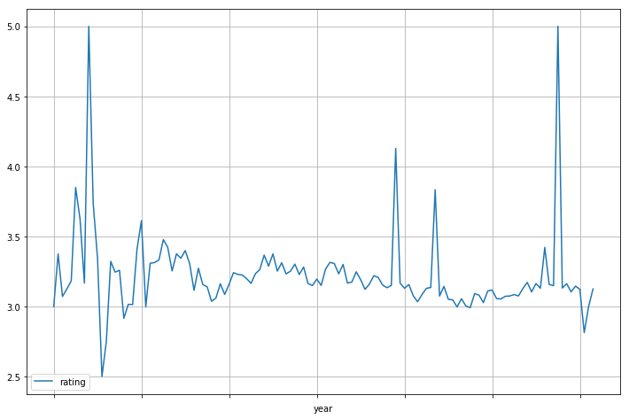
In [102]:
yearly_average.plot(x='year', y='rating', figsize=(12,8), grid=True) plt.show()

